Slide 1
IDENTIFYING SECTORAL-SPATIAL CONCENTRATIONS: METHODS AND POLICY IMPLICATIONS
Dr. Chris van Egeraat
Maynooth University, Ireland
Paper presented at Policy Forum Rethinking Irish Economic Development
UCC November 2017

Slide 2
Outline (a split mind)
An innovative method for identifying substantial spatial concentrations of industrial sectors
Van Egeraat, C. Morgenroth, E., Curran, D., Kroes, R. and Gleeson, J. (2016) A measure for identifying substantial geographic concentrations, Papers in Regional Science
Spatial scale of a cluster and related policy
Van Egeraat, C. and Curran, D. (2013) Spatial Concentration in the Irish Pharmaceutical Industry: The Role of Government Intervention and Agglomeration Economies, Journal for Economics and Social Geography. 104, 3, pp. 338-358

Slide 3
Current indices informing cluster policy
Regional industrial policy inspired by a range of territorial production concepts
These point to benefits of geographically concentrated groupings of firms in the same industry.
Identification is based on geographical concentration and industrial specialisation indices

Slide 4
Downsides existing indices and methods
Regional Industrial specialisation measures
Measure how similar/dissimilar a region’s industrial structure is relative to that of a reference area
Industries with a LQ>1 in a region are often deemed regional industrial concentrations
A regional specialisation ≠ a substantial industrial concentration.
Small number of firms/employees, in a small county, is interpreted as a cluster
A large number of firms/employees, in a large county, is not interpreted as a cluster
Pre-specified administrative boundaries – not meaningful to configuration of industries

Slide 5
Index for identifying substantial concentrations
Not based on specialisation, but on disproportionately large share of the national sector in a specific area.
Taking account of number of firms and number of employees
An industry is over-represented in a region if the share of employment and number of firms is twice as high as expected on the basis of a uniform distribution.
This cut-off varies per region
Physical size of the spatial unit (cut-off is higher for larger counties)
This cut-off varies per industry
Controlling for the size-distribution of the concentrations

Slide 6
Method for creating meaningful areas
How to identify meaningful industry-specific discrete areas?
Let the point data in data set determine the boundaries
Create labour fields around each plant. Size of the field determined by travel-to work data related to the ED in which the plant is located
Merge overlapping labour fields resulting in industry specific discrete area

Slide 7
Data
Forfas Employment Survey
Agency client firms (IDA, Enterprise Ireland etc.)
Location (X/Y)
Employment size
Sectoral codes

Slide 8
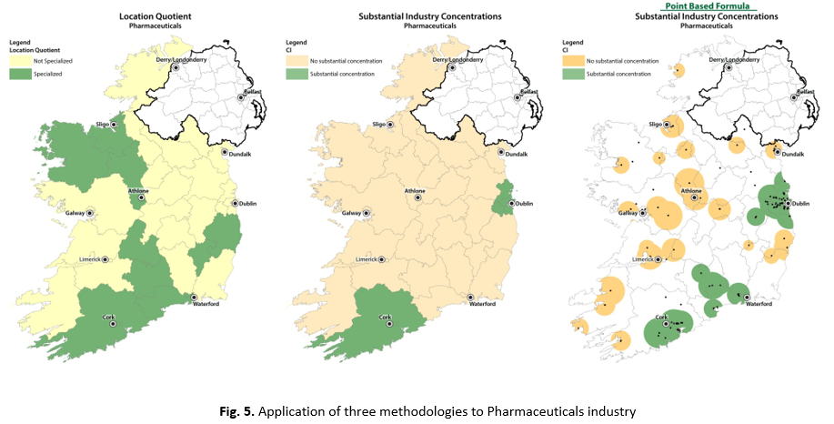

Slide 9
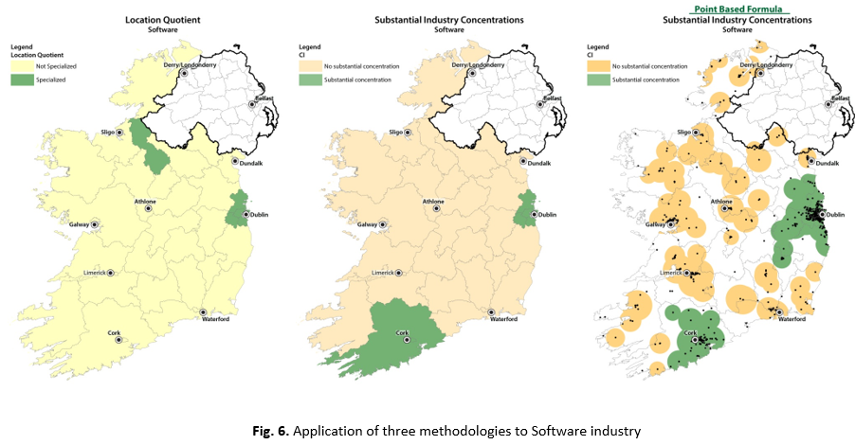

Slide 10
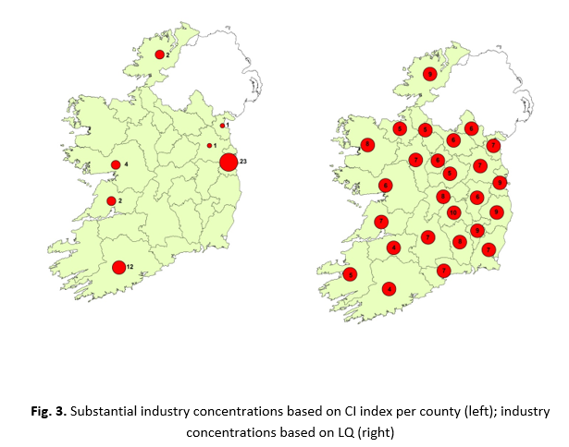

Slide 11
Conclusion and Policy Recommendation - A
Stop using meaningless indictors to inform cluster policy

Slide 12
The Spatial Scale of Clusters in a small country
Van Egeraat, C. and Curran, D. (2013) Spatial Concentration in the Irish Pharmaceutical Industry: The Role of Government Intervention and Agglomeration Economies, Journal for Economics and Social Geography. 104, 3, pp. 338-358

Slide 13
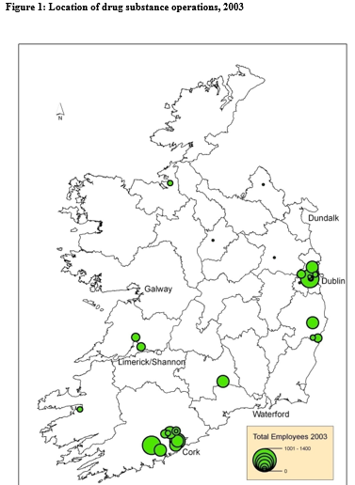
Relevance of a Cluster Approach to a small country

Slide 14
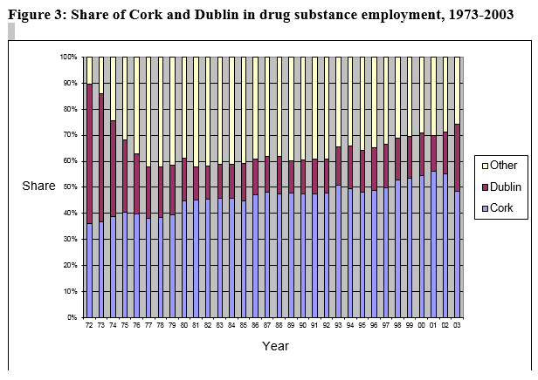
Relevance of a Cluster Approach to a small country

Slide 15
Some findings
“… the high level of concentration of the drug substance sector […] has largely been driven by regional spatial planning policy and the related spatially selective provision of well-serviced industrial sites and infrastructure”
“…the Cork concentration, even after forty years of existence, has not generated substantial (sector-specific) localisation economies”
Firms derive a level of urbanisation economies (e.g. third-level institutions providing suitably qualified labour)
“these economies have also been available in several other urban centres [which] means that they cannot serve as an explanation for the particular concentration of the plants in Cork and Dublin.”
“All the colleges in the country are supplying the people who work in the area. So the pharma sector is a national industry. It does not matter which university, your skill is to the same level.”
“Under a changed spatial planning regime, the provision of suitable sites and utilities in Dublin instigated a substantial shift in the location of new drug substance plants.” [And more recently Waterford (Servier) Limerick (Regeneron)]

Slide 16
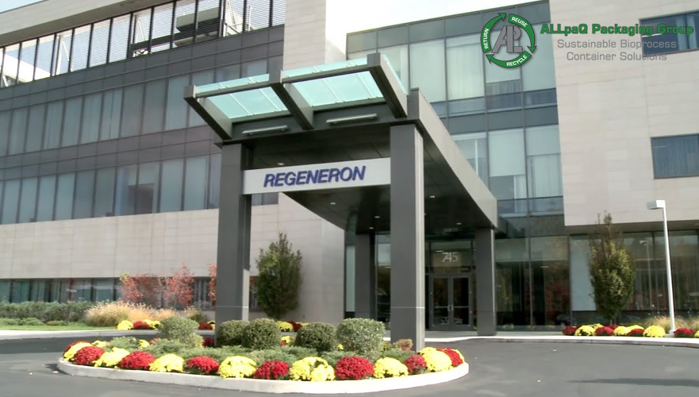
Recent investments in Limerick (800 employees)

Slide 17
Conclusion - B
Some sectors enjoy agglomeration advantages at the city-region scale. But these advantages are not that great that they cannot be balanced by small incentives at other locations
For some sectors (or activities) the agglomeration advantages operate at a national scale (although they may require an urban location)
Exceptions: Financial services, medical devices (R&D element)
We need to establish the relevant spatial scale for cluster policy.

